Slide 1


Advanced topics in single-cell transcriptomics - streamed
27 - 29 May 2020 Alma Andersson, Panagiotis Papasaikas, Mike Smith, Charlotte Soneson, Avi Srivastava, Michael Stadler

Slide 2

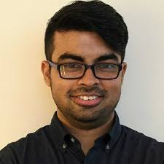
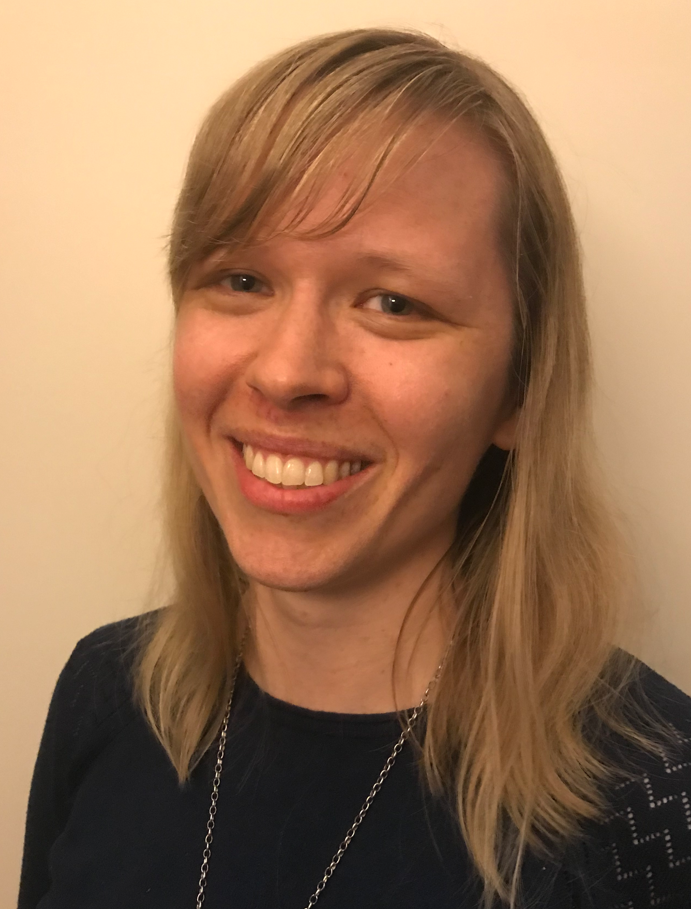

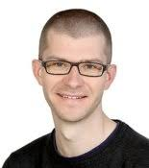
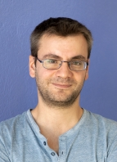
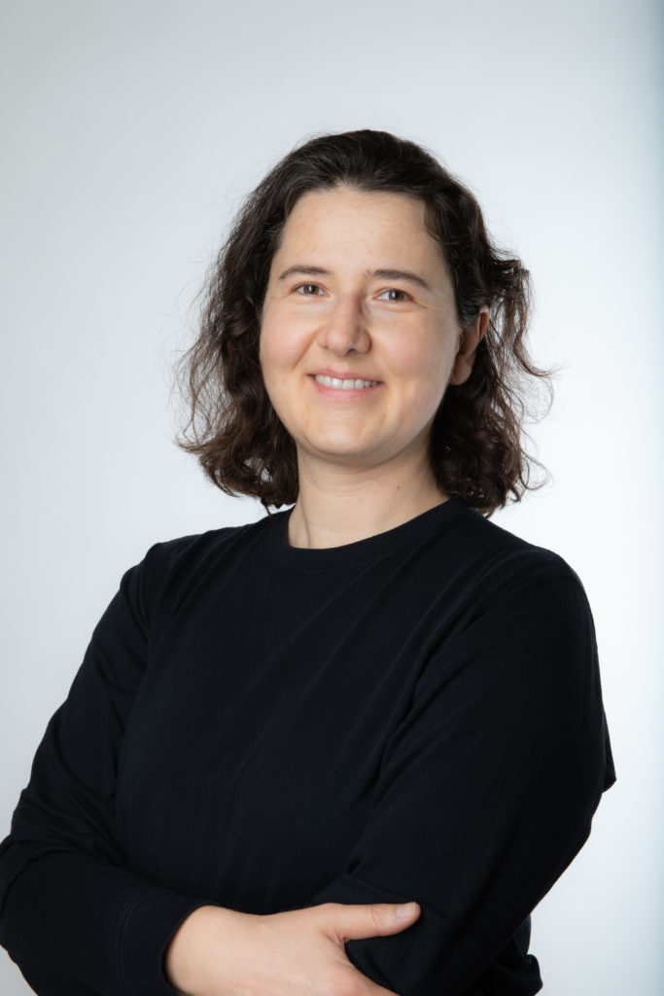
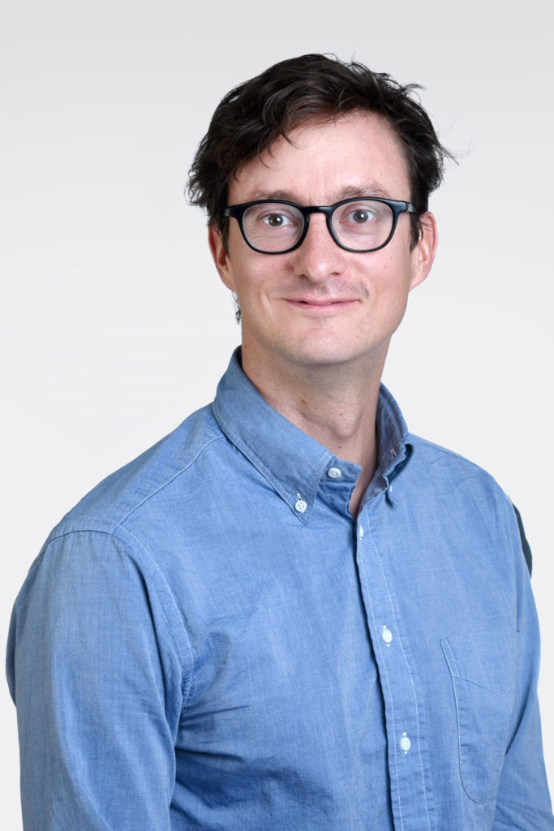
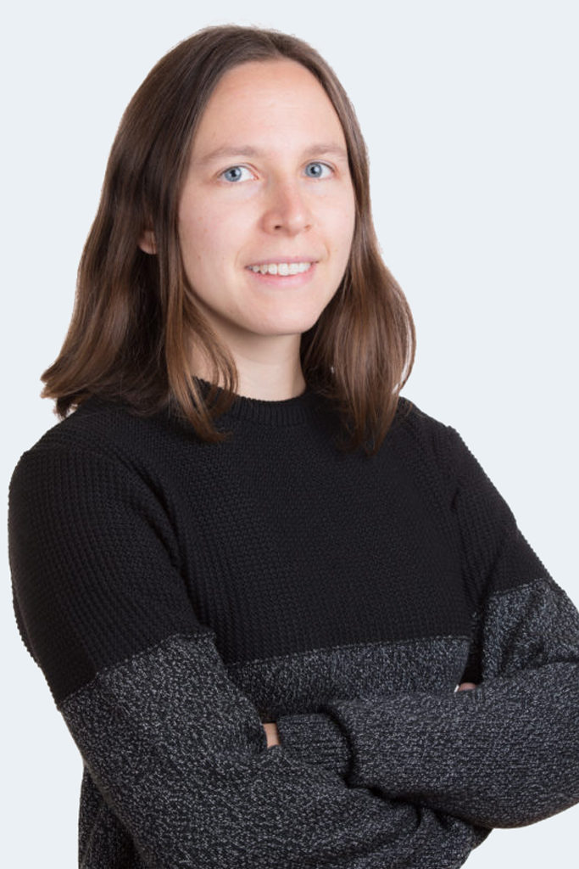
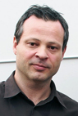
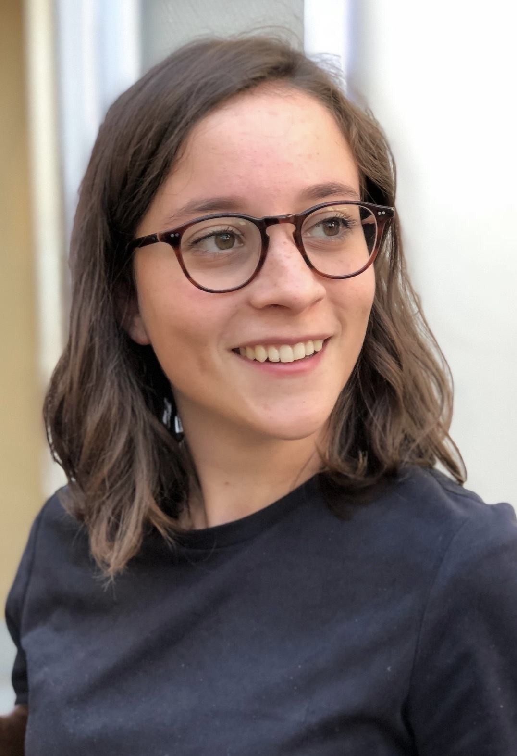
Welcome
Michael
Avi
Charlotte
Alma
Mike
Panagiotis
Christine
Rok
Emma
Gregoire
Margaux

Slide 3
Setup of working environment
Zoom
Test important functionality (breakout rooms, feedback signs, polls)
Slack workspace
Exchange between course participants, quick questions, technical support
Will exist beyond the course
HackMD document
Collaborative note taking, questions
This is a professional environment – we expect professional behaviour

Slide 4
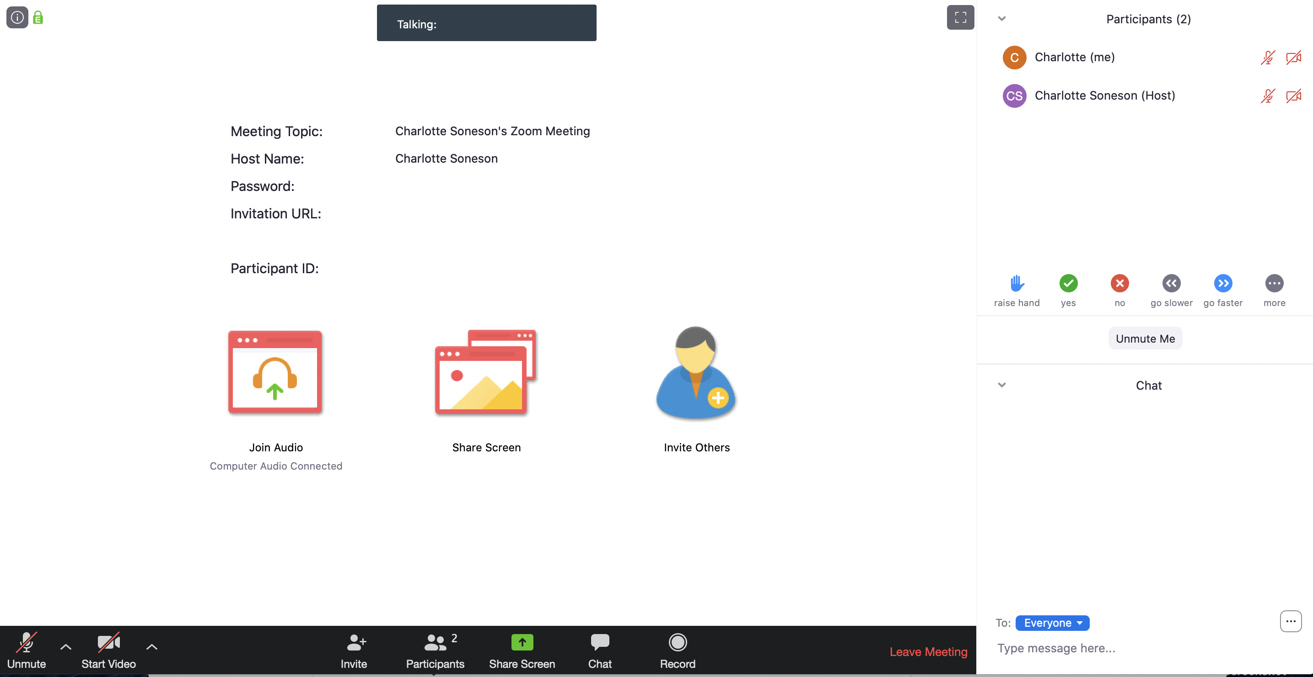

Slide 6
Please click on “yes”

Slide 7
Preferably use
slack instead!

Slide 8
Setup of working environment
Zoom
Test important functionality (breakout rooms, feedback signs, polls)
Slack workspace
Exchange between course participants, questions, technical support
Will exist beyond the course
HackMD document
Collaborative note taking, questions
This is a professional environment – we expect professional behaviour

Slide 9
Setup of working environment
Zoom
Test important functionality (breakout rooms, feedback signs, polls)
Slack workspace
Exchange between course participants, questions, technical support
Will exist beyond the course
HackMD document
Collaborative note taking, questions
This is a professional environment – we expect professional behaviour

Slide 10
Setup of working environment
Zoom
Test important functionality (breakout rooms, feedback signs, polls)
Slack workspace
Exchange between course participants, questions, technical support
Will exist beyond the course
HackMD document
Collaborative note taking, questions
This is a professional environment – we expect professional behaviour

Slide 11
“Ice-breaker” + Zoom poll testing

Slide 12
Useful Links
SIB course page:
https://www.sib.swiss/training/course/2020-05-adv-scrna (announcement)
https://edu.sib.swiss/course/view.php?id=458 (moodle, participants only)
Course GitHub repository (slides, handouts):
https://github.com/fmicompbio/adv_scrnaseq_2020
Renkulab project (compute environment):
https://renkulab.io/projects/stadler.michael/adv_scrnaseq_2020
R/Python:
https://rstudio.github.io/reticulate/
https://rpy2.github.io/
Single cell RNA-seq analysis:
https://osca.bioconductor.org/

